Slide 1
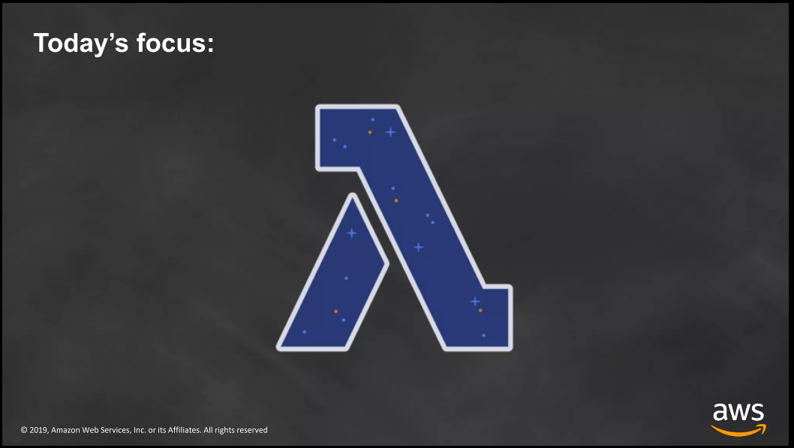

Slide 2
What is AWS Lambda
AWS Lambda is an event-driven, serverless computing platform provided by Amazon as a part of Amazon Web Services. Therefore you don’t need to worry about which AWS resources to launch, or how will you manage them. Instead, you need to put the code on Lambda, and it runs.
It is a computing service that runs code in response to events and automatically manages the computing resources required by that code. It was introduced on November 13, 2014.
What is Server less
Serverless is a term that generally refers to serverless applications. Serverless applications are ones that don’t need any server provision and do not require to manage servers.
Serverless is a cloud-native development model that allows developers to build and run applications without having to manage servers or infrastructure.

Slide 3
Use Cases of AWS Lambda
AWS Lambda used for a wide range of applications like
Helps you for ETL process (Extract, Transform, Load)
Allows you to perform real-time file processing and real-time stream processing
Use for creating web applications
Data processing (real-time streaming analytics)
Automated Backups of everyday tasks
Scalable back ends (mobile apps)
Helps you to execute server-side backend logic
Allows you to filter and Transform data
Pay a

Slide 4
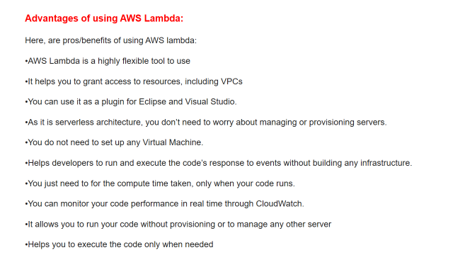

Slide 5
Benefits of Lambda:
No servers to manage.
Continuous scaling.
Millisecond metering.
Increases innovation.
Modernize your applications.
Support for developers.

Slide 6
Following are the major disadvantages of giving up system control to platform vendors while using a Serverless Architecture like AWS Lambda:
State Restrictions.
DoS (Denial of Service)
Limited Execution Duration.
Startup Latency Issue.
Testing Obstacles.
Execution Challenges.
Monitoring and Debugging Limitations.

Slide 7
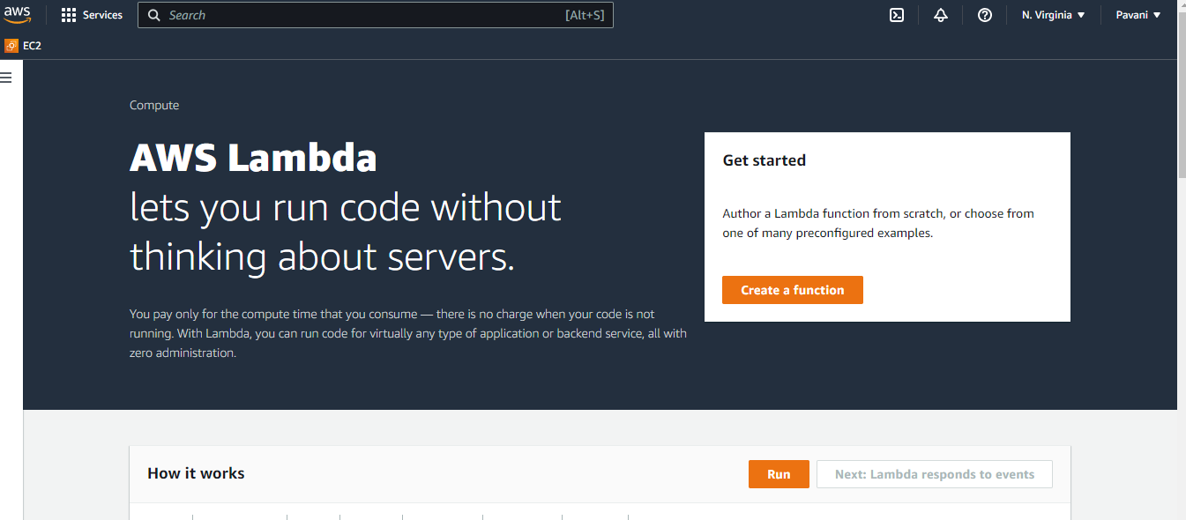

Slide 8
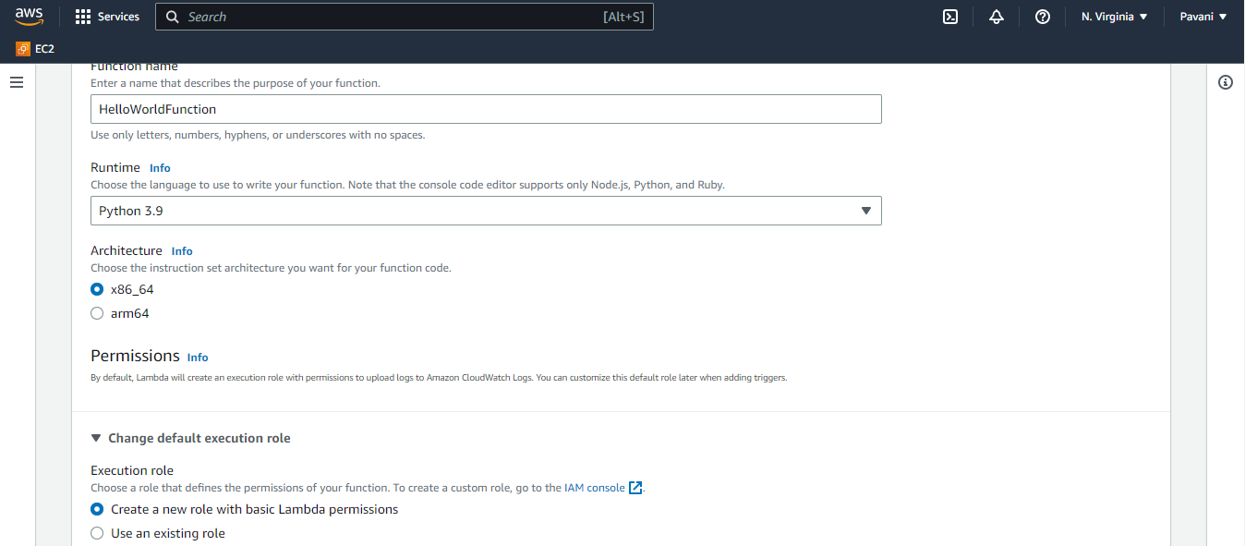

Slide 9
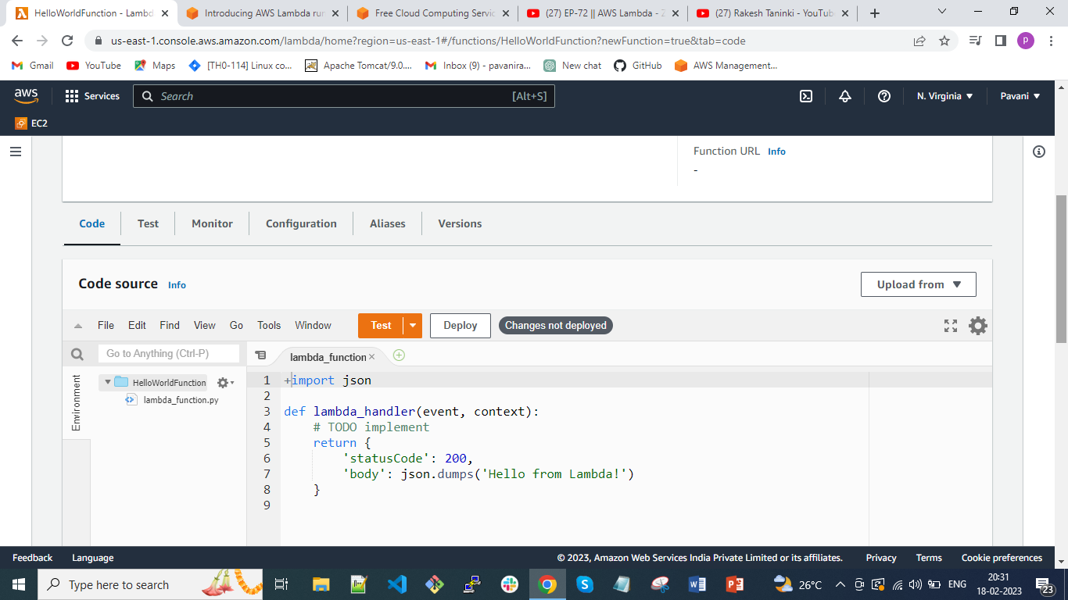
-- Done by Pavani

Slide 10
Thank you

